Slide 1



Slide 2




01
02
EXCEL
POWERBI
4
MODULES
03
04
SQL
TABLEAU

Slide 3



Project Team Overview
Team Members
Aniket Kumar Singh
Karan Jasutkar
Palem naresh
Mohamad shafi
Ch Jayant
Jarugumalli Kasi Viswanadh
Team’s Goal
Creating a comprehensive dashboard covering multiple KPIs using Excel, Tableau, Power BI, and MySQL

Slide 4
DATA SET UNDERSTANDING
IN THE GIVEN DATA SET WE HAVE TO ANALYSE THAT WHAT ARE THE MAJOR RESTAURANTS IN SALE AND WHICH ARE THE RESTAURANTS HAVING THE HIGHEST RATING AND THEN ACCORDING TO THIS MANAGER WILL TELL HIS TEAM THAT WHERE THE TEAM NEED TO FOCUS MORE FOR HAVING MORE SALES AND GIVING PROPER TREATMENT TO THE CUSTOMERS AND WHICH COUNTRY IS GIVING GOOD RESPONSE AND WHICH RESTAURANTS ARE NOT ACCEPTING THE ONLINE DELIVERY ,AND BY GIVING THEM A GOOD OFFER CAN MAINTAIN OUR BUSINESS GROWTH AND BUSINESS RELATIONSHIP
ANALYSIS OF THE ZOMATO DATA SET

Slide 5




____________________
0.2
VISUALIZATION ____________________
____________________
0.1 DATA
CLEANING
____________________
____________________
0.3 PREDICTIVE
ANALYSIS
____________________

Slide 6
KPI’S
RESTAURANTS
9551
2 . 89
141
1825
AVERAGE RATING
CITIES
CUISINES

Slide 7
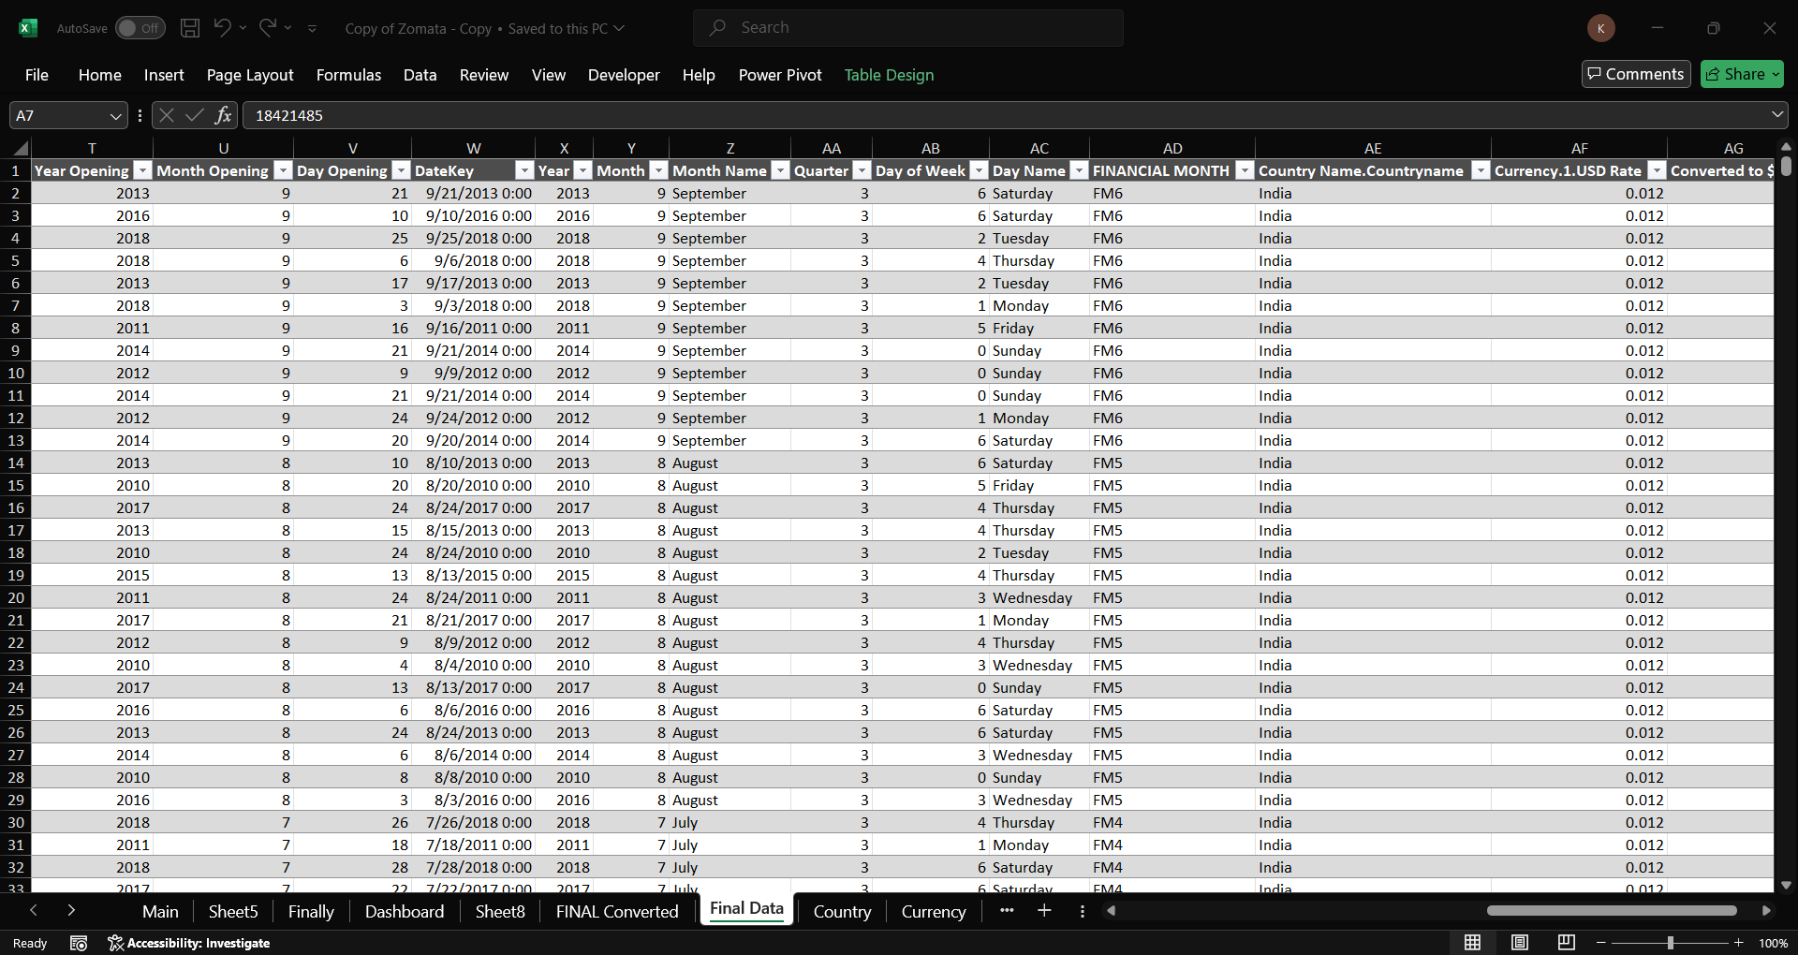
DATA CLEANING

Slide 8
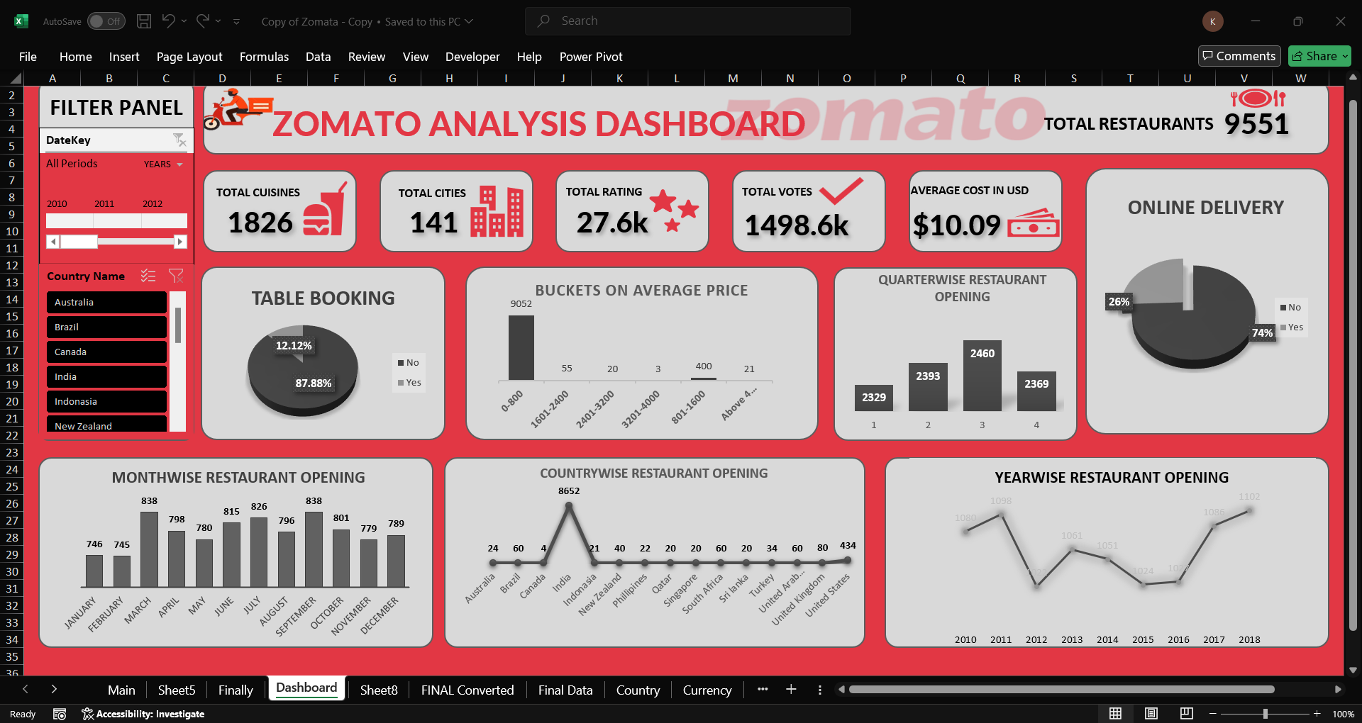
DASHBOARD OF EXCEL

Slide 9
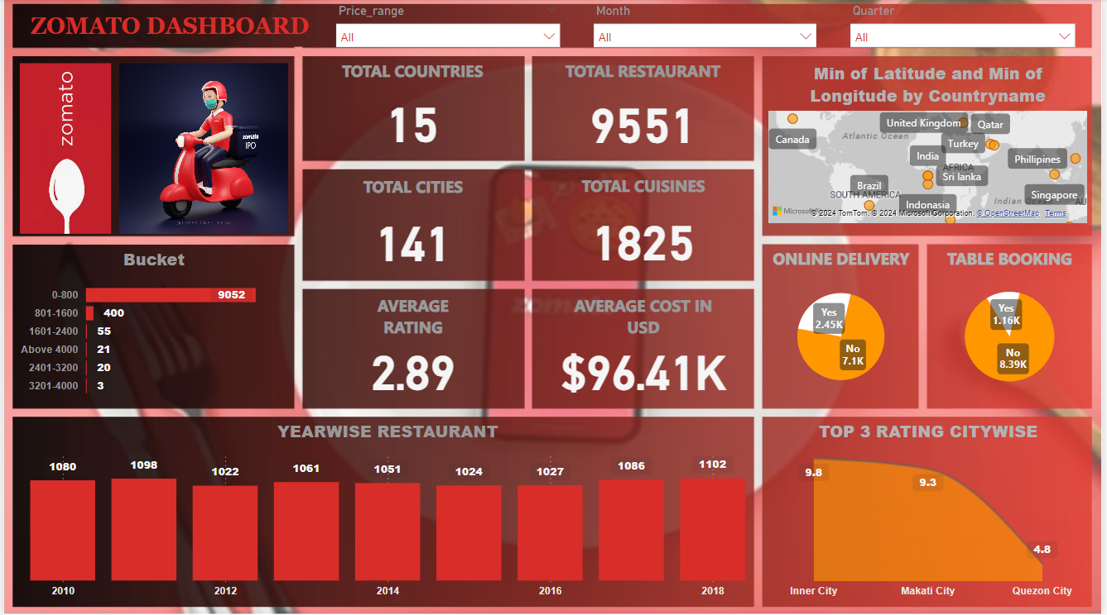
DASHBOARD OF POWERBI

Slide 10
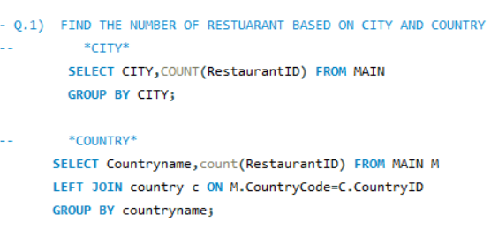
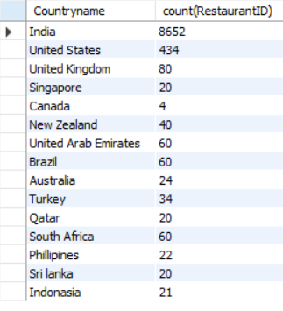
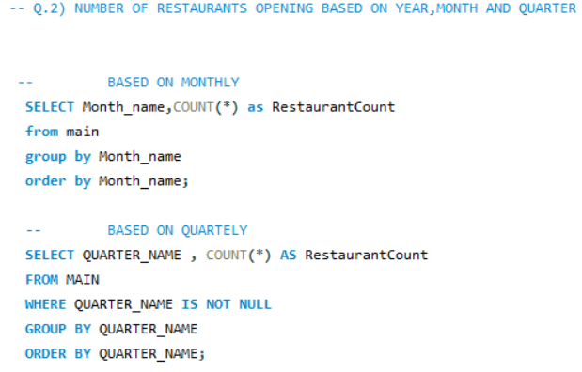
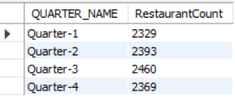
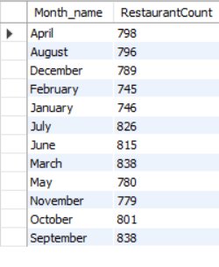
SQL QUERIES
QUERIES
RESULTANT

Slide 11
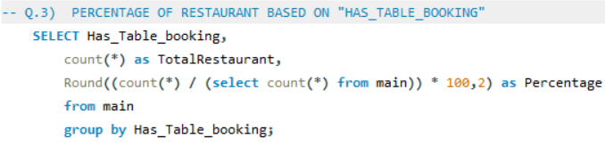
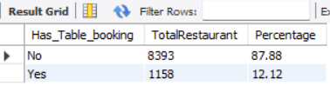
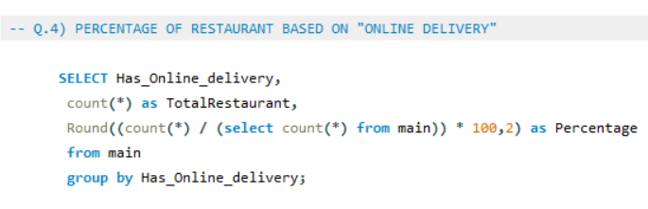
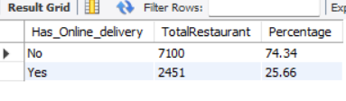
SQL QUERIES
QUERIES
RESULTANT

Slide 12
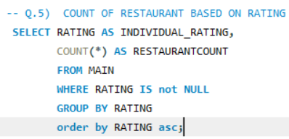
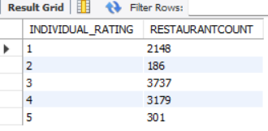

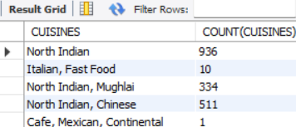
SQL QUERIES
QUERIES
RESULTANT

Slide 13
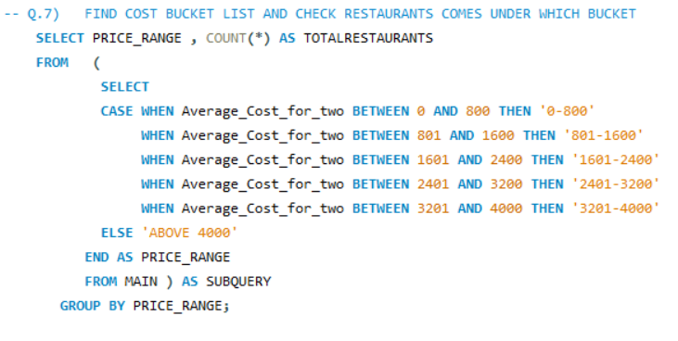
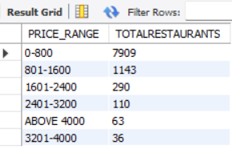
SQL QUERIES
QUERIES
RESULTANT

Slide 14
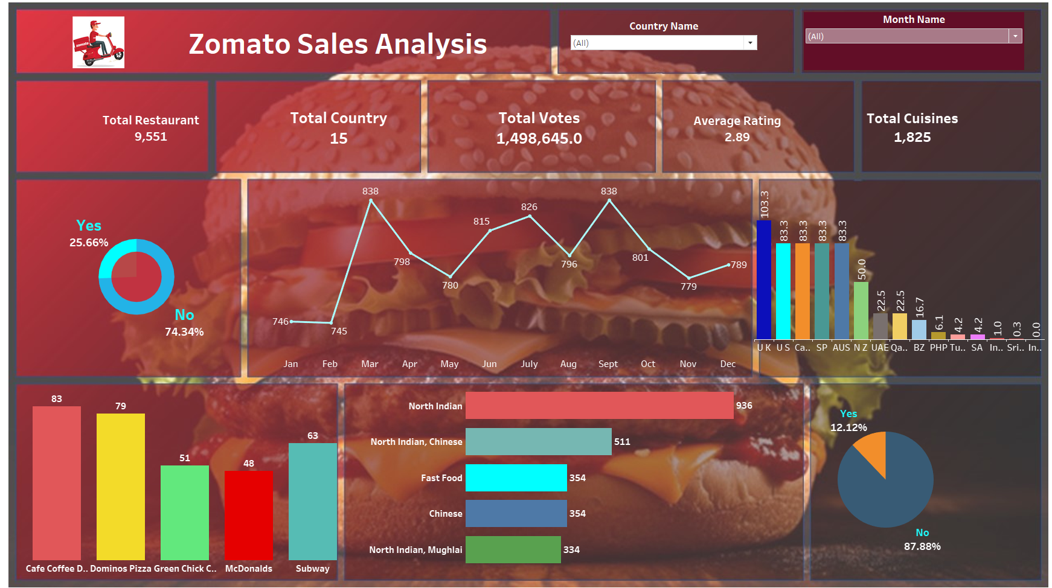
DASHBOARD OF TABLEAU

Slide 15






LEAST RATING DONE BY UNITED STATES
LEAST VOTE DONE BY UNITED STATES
HIGHEST SALES IS IN INDIA
WHICH RESTAURANTS ARE NOT ACCEPTING TABLE BOOKING AND NOT PROVIDING ONLINE DELIVERY
AS WE SAW PRICE RANGE BETWEEN 0-800 ARE GIVING MORE ORDERS

Slide 16

9+--
9+--
THANKYOU

